Slide 1
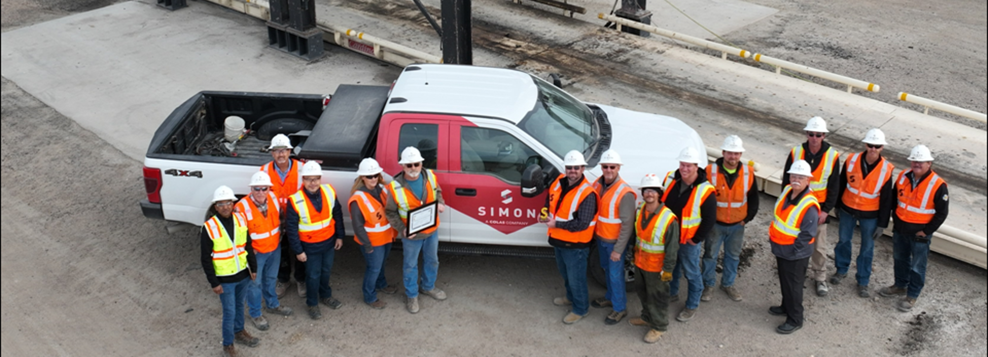

2024 Performance management
People Leader: Best Practices

Slide 2
Performance review process
Timeline
Date | Deliverable
October 15 – November 15 | Preparation (Step 1) – employees complete self-assessments and supervisors complete supervisor assessments; employees submit self-assessments
November 15 – December 1 | Supervisor reviews performance evaluation with functional manager (calibration)
December 1 – December 20 | Supervisor schedules and conducts 1:1 meeting with employee (Step 2) Following 1:1 meeting, employee completes acknowledgment (Step 3)
December 31 | All assigned evaluations are completed (Step 4)
*Reminder: Performance evaluations for hourly field operations employees are due by November 30 OR prior to their seasonal layoff effective date

Slide 3

Performance Review process
Goals and expectations
The Performance Review is an opportunity to reflect on performance and achievements, communicate expectations, increase employee engagement, course-correct and find solutions to any issues, and set goals and identify development goals for the next year.
Employee’s Goals
Supervisor’s Goals
Self-assess current year’s performance
Better know the team and adapt management and coaching style
Share major achievements and roadblocks
Assess job skills, goals’ achievements and set future goals
Discuss current tasks and goals, and suggest future goals
Support the employees’ development

Slide 4
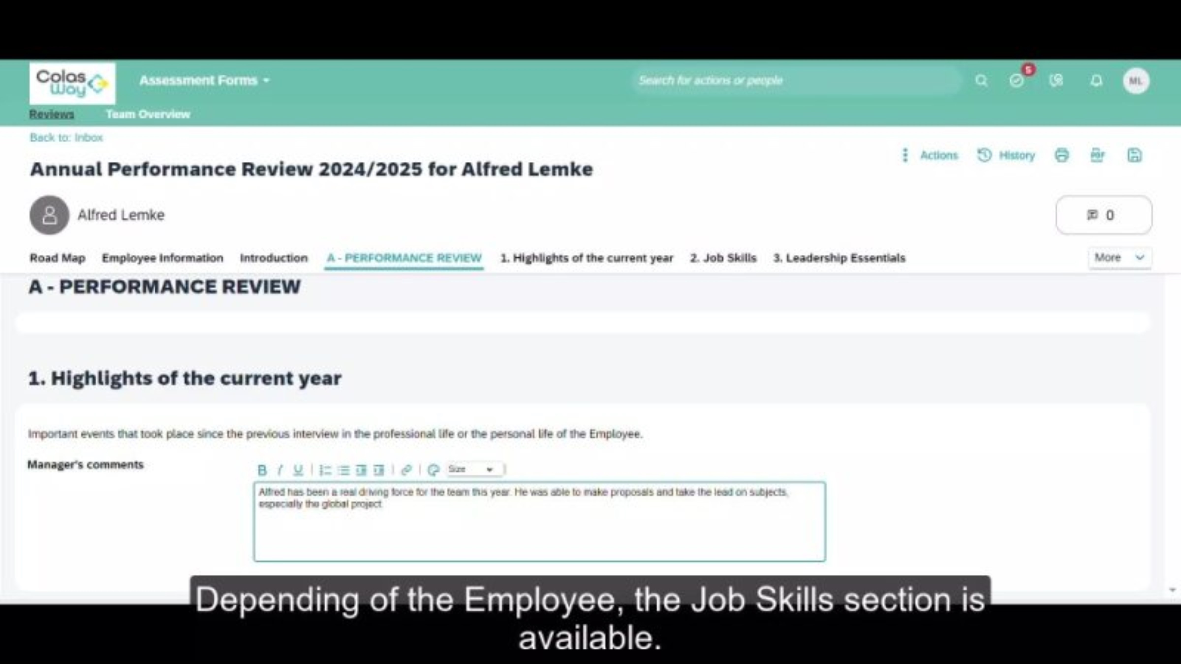
Performance Review Process
Video: manager expectations
Notes:
6:17

Slide 5











Performance Review process
Be sure to:
Set deadlines with your team
Schedule 1:1 meetings with each employee
Overview
1
2
3
4
1
Face to Face and Manager Acknowledgement
Employee’s Acknowledgement
Preparation
Completed
Due Date:
12/31
Mandatory step
Self-assessment (Employee) and assessment (Manager) are not visible on either side
The two preparations are combined, but only the Manager preparation can be modified
All fields are mandatory
Led by the Manager
Manager synthesis and signature
Performance Review overview
Employee synthesis and signature
No field can be modified
A summary of the assessments is available in the Scorecard tab of the Employee File
Mobility feeds the CV
Key :
Manager
Employee
Person who ‘leads’ the Performance Review form

Slide 6

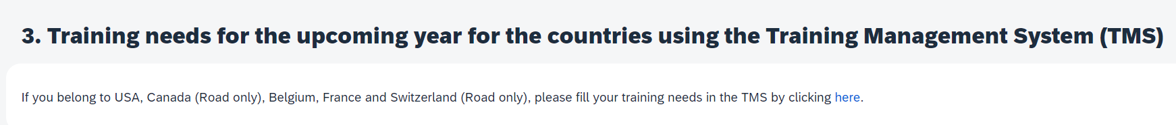


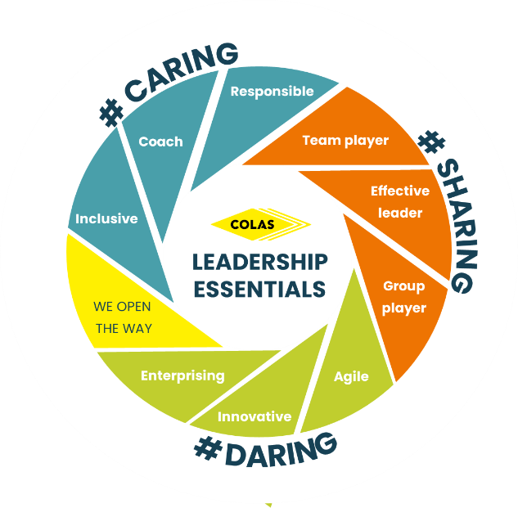
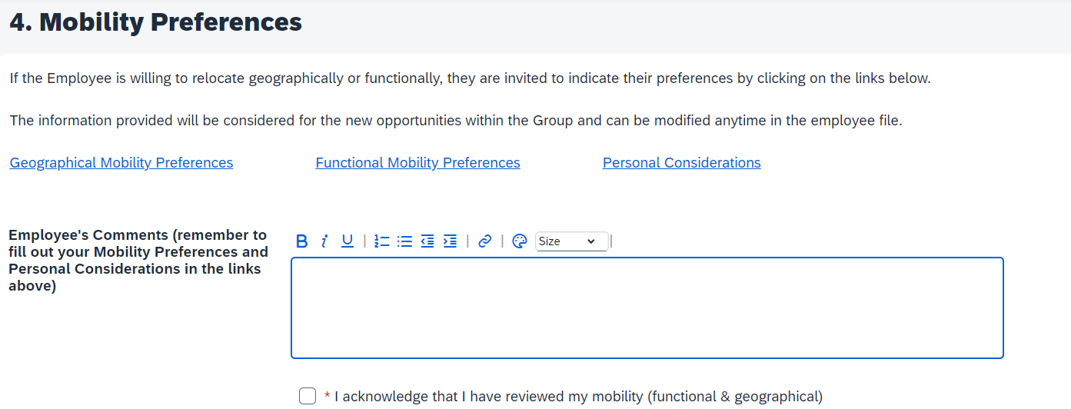

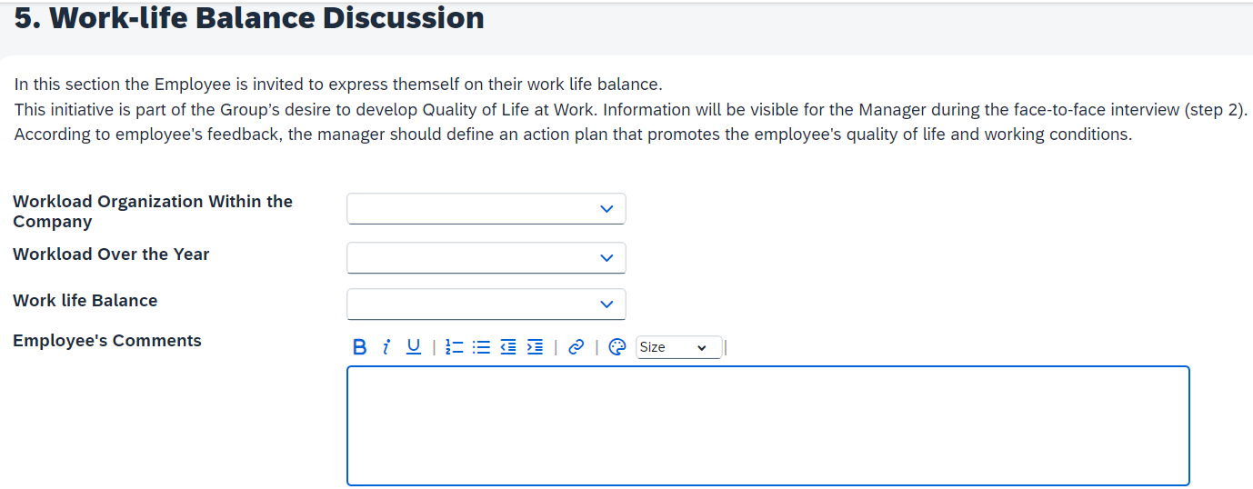
Performance review: new this year
Pro Tip:
Weightings of Leadership Essentials / Job Skills / Achievement of 2024 Performance Goals may vary based on employee’s classification

Slide 7





Performance review: pro tips
Pro Tip: Nobody’s performance is 5 stars across the board!
Rating Definitions
Rating | Rating Definition | ColasWay Icon
1 | Not Sufficiently Demonstrated: The behavior has not been sufficiently demonstrated in practice
2 | Needs Further Development: The behavior has been demonstrated but needs to be applied in practice
3 | Suitably Demonstrated: The behavior has been demonstrated and is suitably applied in practice
4 | Strongly Demonstrated: The behavior has become part of the employee's daily life and they share it with their colleagues
5 | Exemplary: The behavior has been fully internalized by the employee, who is impacting it to other colleagues or team members

Slide 8
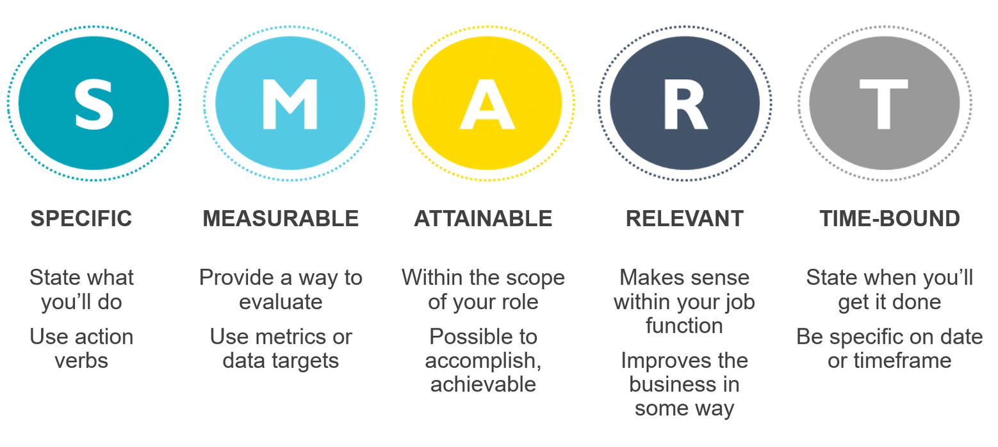
Performance review: pro tips
Pro Tip: Add at least one performance goal for 2025
Set smart goals
Pro Tip: Be on the lookout for SMART goals training early 2025

Slide 9
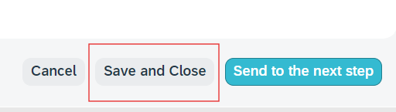
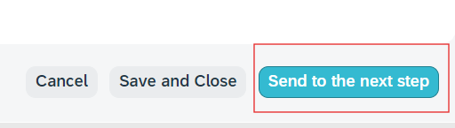
Performance review: pro tips
Set smart goals
Every time you exit out of the performance review, you must click:
Save and Close
Wait until just prior to your scheduled one on one with your direct report to share with them by clicking:
Send to the next step

Slide 10
Performance review: one on one meeting
Remember HIP:
What Happened?
What was the Impact?
What’s the Plan going forward?
Manage employee reactions
Phrase the feedback accurately
Ensure that you use simple words and supporting examples to deliver formal and informal feedback. Poorly crafted and delivered messages can trigger feelings of self-doubt, anger, shock or resistance.
Allow the employee to speak openly
Let your direct report vent their feelings about the feedback. Make the employee feel respected by allowing them to share their true reactions and emotions with you.
Observe signs of emotional reactions
Observe the employee’s choice of words, tone and facial expressions to assess the emotions and respond accordingly.
Keep the cool & respond with empathy
If the employee acts shocked, aggressive or defensive, maintain your composure. Be considerate yet firm with the employee and reiterate your point with substantial examples and next steps.

Slide 11
Performance review: one on one meeting
Manage negative employee reactions
Employee Reaction | Sample Employee Statement | Guidelines for Manager Response | Sample Manager Response
Hostility/Resistance/ Denial | “I don’t know what you’re talking about. I provide great customer service!” “I do not accept your feedback regarding my project management skills. The incident you cited did not take place.” | Listen actively to ensure the employee understands the message. Repeat or restate comments if necessary. Gauge the employee’s reasons for resistance. Candidly discuss the consequences if the employee does not address the development area. | “Let’s review the examples I gave of areas where I see an opportunity for improvement.” “Let’s give you some time to reflect on the feedback I’ve provided and reconnect tomorrow morning.” “This is an opportunity for you to improve your performance. Disregarding it will continue to impact your performance reviews down the line, as well as the future opportunities available to you here at the organization.”
Self-Pity/Lack of Confidence | “I don’t know where to start from.” “I knew this would happen; I can never do anything correctly.” | Give the employee time alone to regain composure, if necessary. Highlight that this is an opportunity to improve. Reassure that you will provide support. Provide examples of small steps to take for improvement. | “Now that we have identified this area for development, it is an opportunity for you to improve your performance. I firmly believe you are capable of achieving this goal. I’ve seen you achieve similar development goals in the past, for example…” “You will have support from me as you work on this. For example…” “Let’s talk about what you can do to improve in this area.”

Slide 12
Performance review: one on one meeting
Manage negative employee reactions
Employee Reaction | Sample Employee Statement | Guidelines for Manager Response | Sample Manager Response
Indifference | “Maybe; I’ll see what I can do.” “I can’t make any promises, but I’ll try.” “Sure, whatever you say.” | Ask the employee to reflect on the development areas and confirm if they can commit to them. Discuss the consequences of denial if the employee does not commit to improving. | “I’d like you to think about what we discussed and whether it’s something you can put the required effort toward developing.” “It’s important to let me know if this isn’t something you can make a full commitment to. If you decide it’s something you can’t do then that’s acceptable, but then we’ll need to talk about the consequences.”
Anger/Shock | “This is not fair! I always knew you didn’t like me, but this is unreasonable.” “I’ve been working so hard to meet all of my project deadlines, and this is what I get to hear?” “I was expecting a promotion, and I think I deserve it.” | Allow employee to vent feelings. Do not get defensive or argumentative. Remain calm. Allow employee time to internalize message. Suggest possible next steps. Use open-ended questions to prompt employee response. | “I can see that you are upset with these results. I would like to hear your opinion.” “If I understand correctly, you are angry because you feel that I have not given you enough challenging assignments, and that I don’t have any confidence in your abilities. Is that correct?”
Responsibility Skirting | “It’s not my fault…” “I’m sorry, but when people ask such basic questions, it is very annoying.” | Listen to the employee’s reasons and situation. Restate the examples. Clarify that the employee will need to meet expectations and improve the development areas despite his or her reasons. | “I know this might be difficult for you to focus on, but the fact remains that I need you to work productively with your peers.” “I know there have been a lot of changes recently, but I still need you to support the change and increase sales in your new territory.”

Slide 13
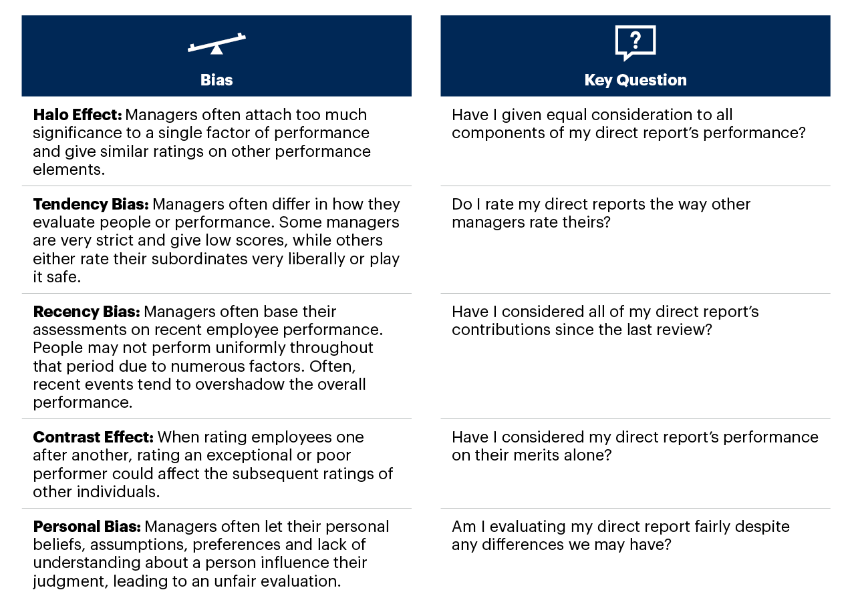
Performance review: one on one meeting
Avoiding common biases

Slide 14

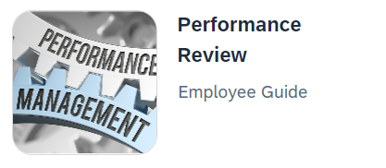
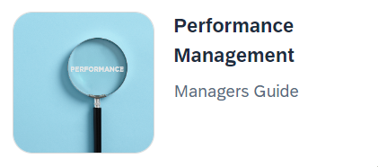
Performance review
resources
Your HR Team
ColasWay Homepage
Coming soon!!
Simon Says Performance Management Page
Regional Office Drop-In Schedule

Slide 15

Performance Review Process
Video: overview
Notes:
3:56

