Slide 1
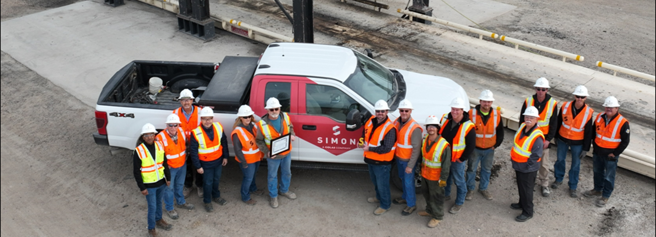

2024 Performance management
Completing Your Self-Evaluation in ColasWay

Slide 2
Performance review process
Timeline
Date | Deliverable
October 15 – November 15 | Preparation (Step 1) – employees complete self-assessments and supervisors complete supervisor assessments; employees submit self-assessments
November 15 – December 1 | Supervisor reviews performance evaluation with functional manager (calibration)
December 1 – December 20 | Supervisor schedules and conducts 1:1 meeting with employee (Step 2) Following 1:1 meeting, employee completes acknowledgment (Step 3)
December 31 | All assigned evaluations are completed (Step 4)
*Reminder: Performance evaluations for hourly field operations employees are due by November 30 OR prior to their seasonal layoff effective date

Slide 3

Performance Review process
Goals and expectations
The Performance Review is an opportunity to reflect on performance and achievements, communicate expectations, increase employee engagement, course-correct and find solutions to any issues, and set goals and identify development goals for the next year.
Employee’s Goals
Supervisor’s Goals
Self-assess current year’s performance
Better know the team and adapt management and coaching style
Share major achievements and roadblocks
Assess job skills, goals’ achievements and set future goals
Discuss current tasks and goals, and suggest future goals
Support the employees’ development

Slide 4
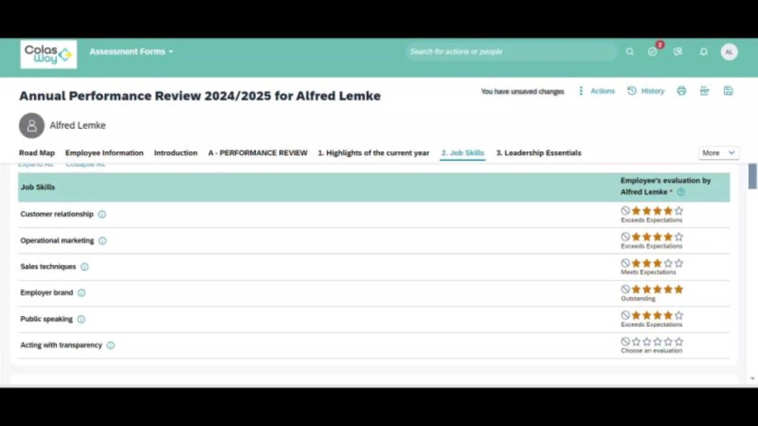
Performance Review Process
Video: Employee expectations
Notes:
6:28

Slide 5











Performance Review process
Due Date:
11/15
Overview
1
2
3
4
1
Face to Face and Manager Acknowledgement
Employee’s Acknowledgement
Preparation
Completed
Due Date:
12/31
Mandatory step
Self-assessment (Employee) and assessment (Manager) are not visible on either side
The two preparations are combined, but only the Manager preparation can be modified
All fields are mandatory
Led by the Manager
Manager synthesis and signature
Performance Review overview
Employee synthesis and signature
No field can be modified
A summary of the assessments is available in the Scorecard tab of the Employee File
Mobility feeds the CV
Key :
Manager
Employee
Person who ‘leads’ the Performance Review form

Slide 6

Performance review
Consider these questions when assessing your performance…
What feedback can I get from others (matrix managers, peers, etc.)
What examples can I share of my accomplishments?
What did I accomplish?
How did I accomplish it?
What were some of my big milestones?
What new skills did I learn/hone this year?
What does my future look like at Simon?
What feedback can I provide my manager?

Slide 7
Performance review
Dos and don’ts when assessing your performance…
DO:
DON’T:
Be as specific as possible
Provide examples
Use metrics
Be as honest as possible
Brag about yourself
Use the comments sections
Just check the box: your merit and career path depends on a self assessment
Rate yourself as all 4s and 5s
Sell yourself short

Slide 8

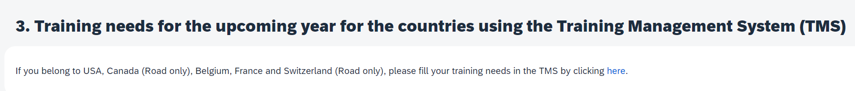


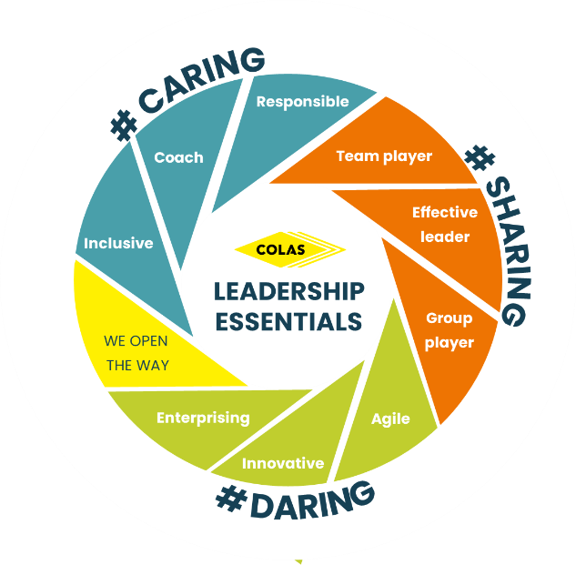
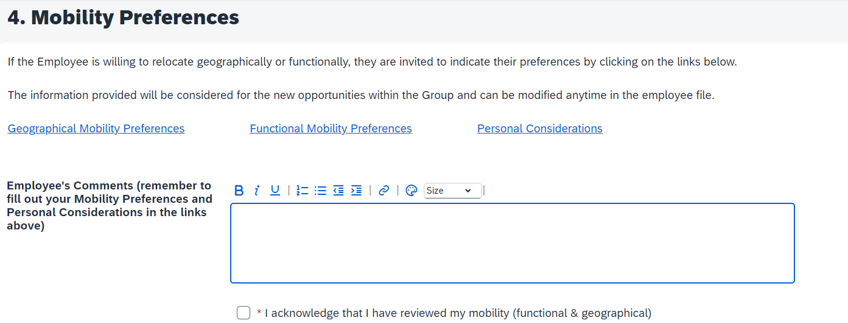

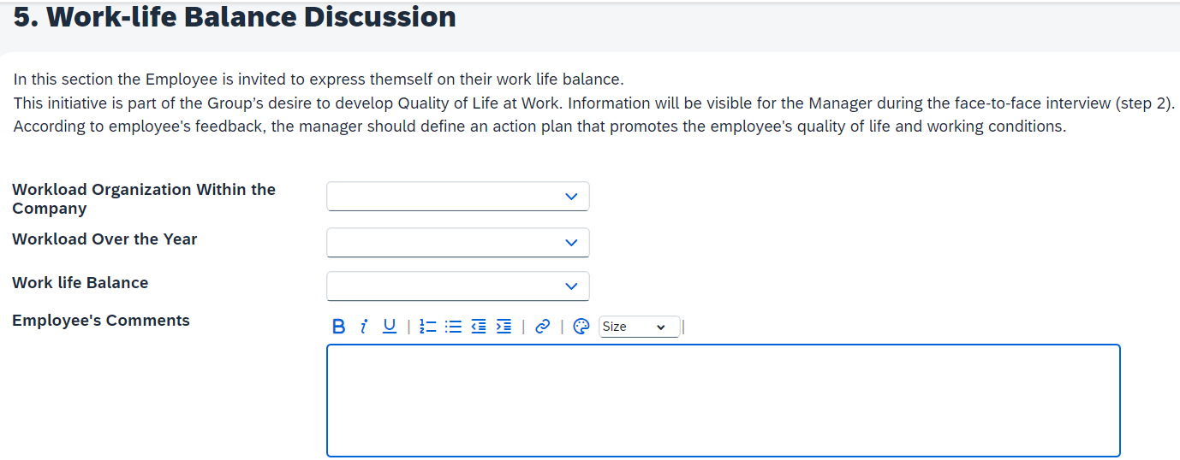
Performance review: new this year
Pro Tip:
Weightings of Leadership Essentials / Job Skills / Achievement of 2024 Performance Goals may vary based on employee’s classification

Slide 9





Performance review: pro tips
Pro Tip: Nobody’s performance is 5 stars across the board!
Rating Definitions
Rating | Rating Definition | ColasWay Icon
1 | Not Sufficiently Demonstrated: The behavior has not been sufficiently demonstrated in practice
2 | Needs Further Development: The behavior has been demonstrated but needs to be applied in practice
3 | Suitably Demonstrated: The behavior has been demonstrated and is suitably applied in practice
4 | Strongly Demonstrated: The behavior has become part of the employee's daily life and they share it with their colleagues
5 | Exemplary: The behavior has been fully internalized by the employee, who is impacting it to other colleagues or team members

Slide 10
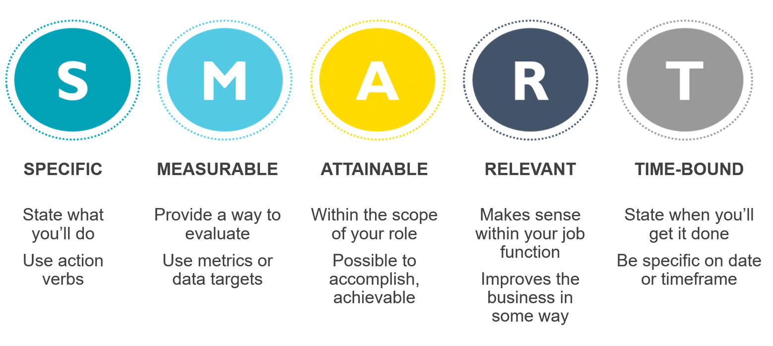
Performance review: pro tips
Pro Tip: Add at least one performance goal for 2025
Set smart goals
Pro Tip: Be on the lookout for SMART goals training early 2025

Slide 11
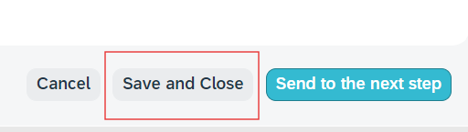
Performance review: pro tips
Set smart goals
Every time you exit out of the performance review, you must click:
Save and Close

Slide 12
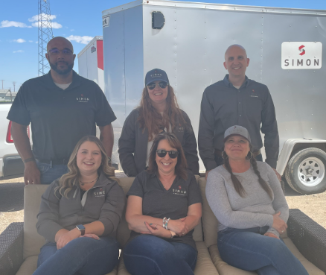
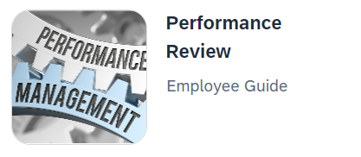
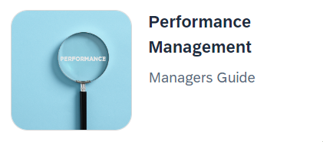
Performance review
resources
Your HR Team
ColasWay Homepage
Coming soon!!
Simon Says Performance Management Page
Regional Office Drop-In Schedule

Slide 13

Performance Review Process
Video: overview
Notes:
3:56

